Slide 1

Unit 1
Lecture 4

Slide 2
Distance Measures
Suppose p(x,y) q(s,t) and z(v,w ) are three pixels
D is the distance function
Distance function D is valid if
D(p,q) >= 0
D(p,q)= 0 iff p=q
D(p,q)= D(q,p) symmetric
D(p,z) <= D(p,q) +D(q,z)
There are different distance measures

Slide 3
1. Euclidean distance
Two points p(x,y) and q(s,t)
D_{e}(p,q) = [(x-s)²+(y-t)²]^{1/2}
2.City block distance(D₄
D₄(p,q)= |x-s| + |y-t|
D₄ =1 four neighbours of p
3.Chessboard distance D₈
D₈(p,q)= max(|x-s|,|y-t|)
D₈ =1 eight neighbours of p

Slide 4
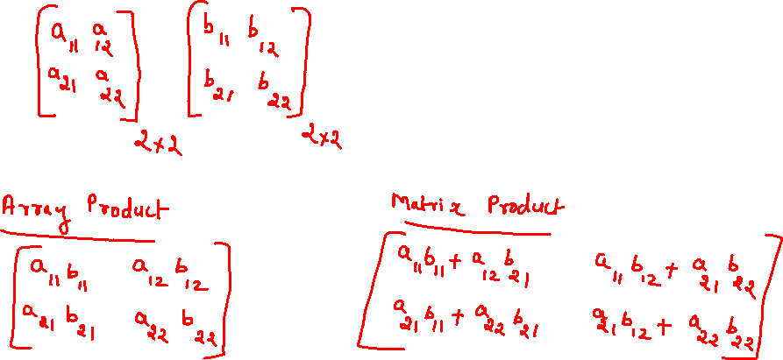
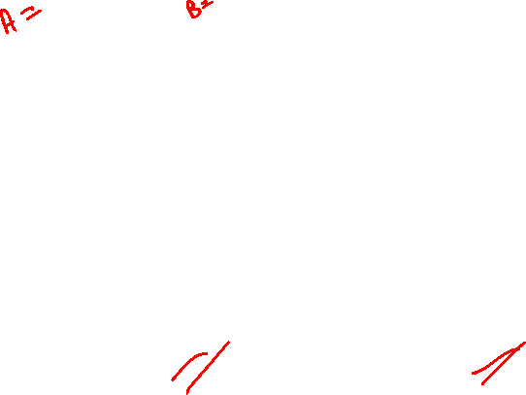
Mathematical tools for image processing
Array vs Matrix operations

Slide 5
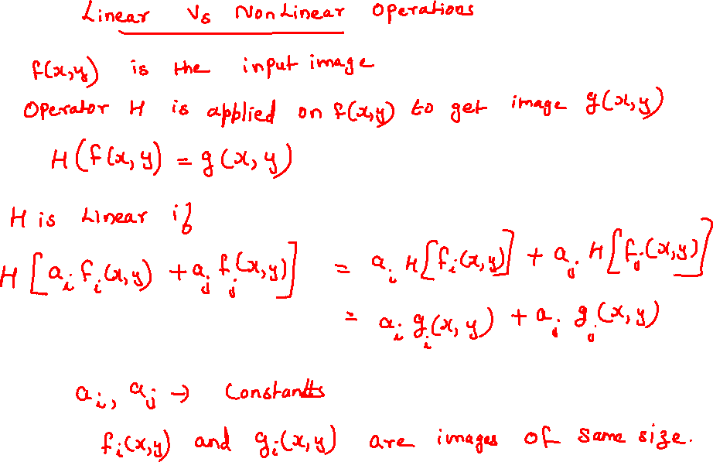

Slide 6
Output of a linear operation done on the sum of two inputs is the same as performing the operation individually on the inputs and summing them up.
Check whether the following operations are linear or not
Sum
Max

Slide 7
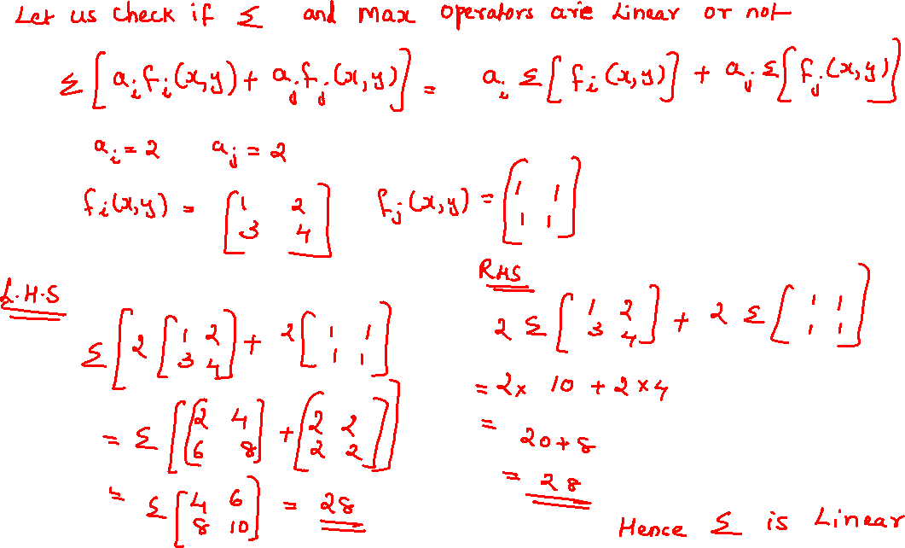
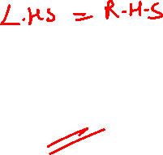

Slide 8
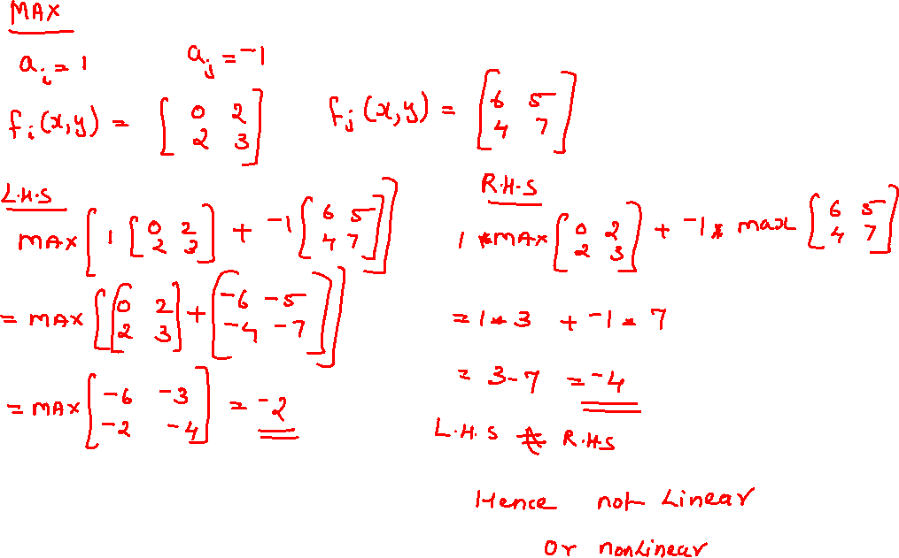

Slide 9
Operations on pixels
Arithmetic Operations
s(x, y) = f(x, y)+g(x, y)
d(x, y) = f(x, y)-g(x, y)
p(x, y) = f(x, y)*g(x, y)
v(x, y) = f(x, y)/g(x, y)
All operations are between corresponding pixels
All images are of same size

Slide 10
Perform the following operations on two sample images
s(x, y) = f(x, y)+g(x, y)
d(x, y) = f(x, y)-g(x, y)
p(x, y) = f(x, y)*g(x, y)
v(x, y) = f(x, y)/g(x, y)

Slide 11
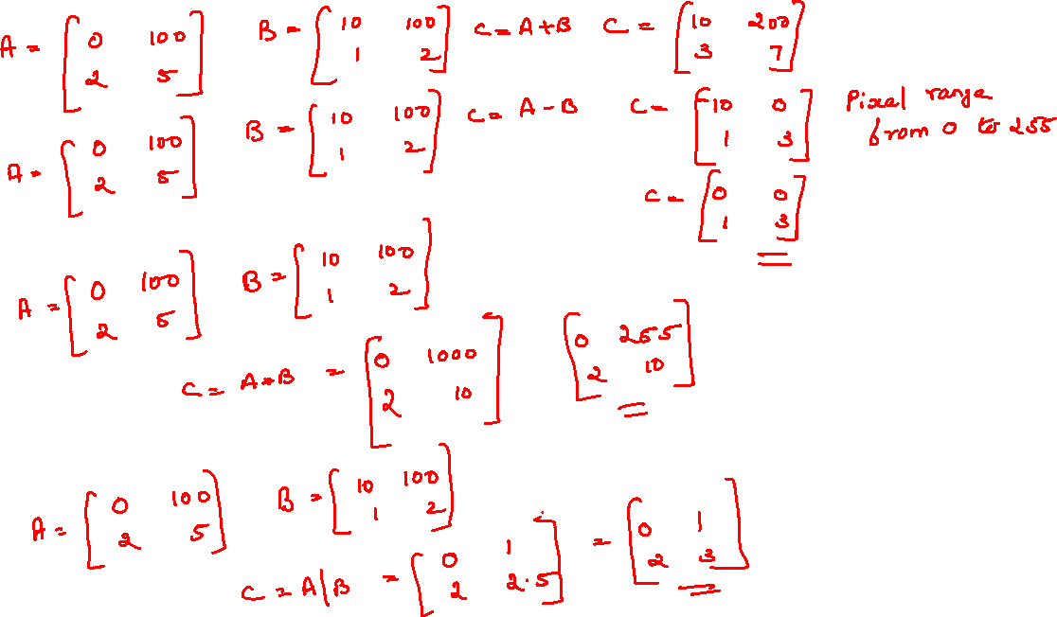


Slide 12
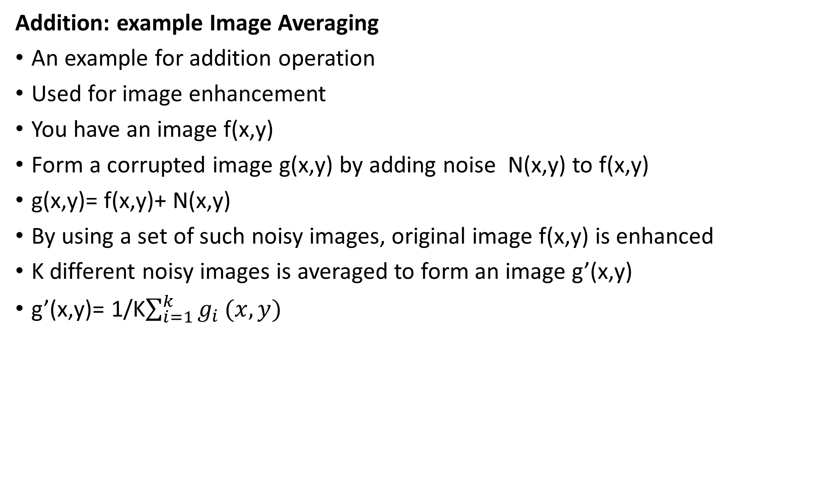
Addition: example Image Averaging
An example for addition operation
Used for image enhancement
You have an image f(x,y)
Form a corrupted image g(x,y) by adding noise N(x,y) to f(x,y)
g(x,y)= f(x,y)+ N(x,y)
By using a set of such noisy images, original image f(x,y) is enhanced
K different noisy images is averaged to form an image g’(x,y)
g’(x,y)= 1/K$\sum_{i=1}^{k}{g_{i}}(x,y)$

Slide 13
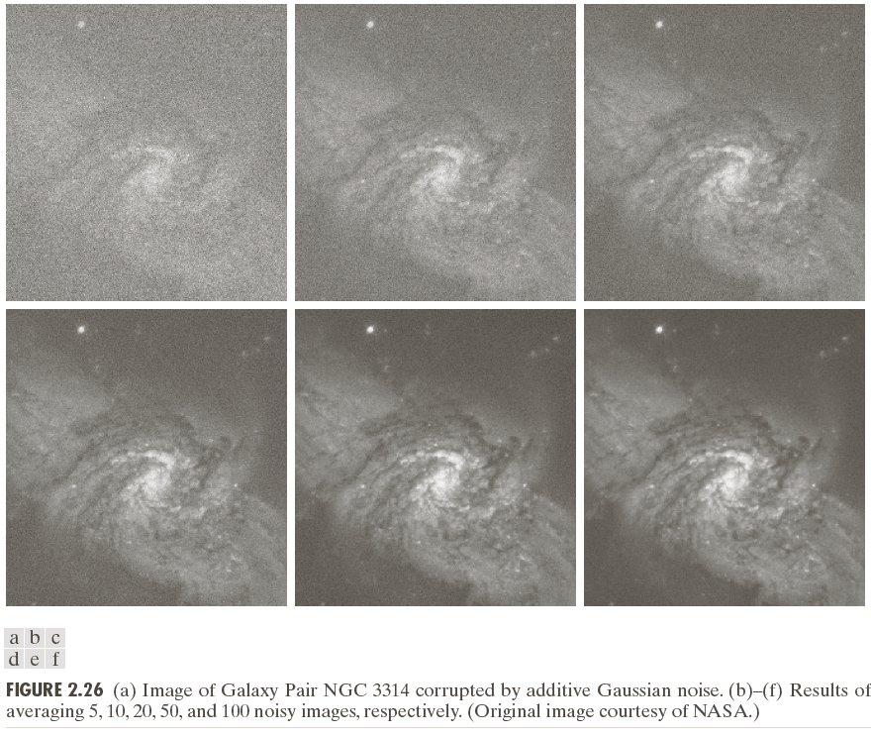
As the SD of the noise decreases there is a visible improvement in the images.
SD of c to f =0.32,0.22,0.14,0.10
Last two output almost looks same, the difference is not detected by human eye

Slide 14
Image Subtraction
g(x,y)= f(x,y)-h(x,y)
Areas which are different in the two images f and h is enhanced
Used widely in medical imaging
Image Multiplication / Division
g(x,y)= f(x,y)*h(x,y)
Used in shading correction
You have a set of images from the sensor denoted as g(x,y)
You wanted to get a perfect image f(x,y)
If the correction h(x,y) is known then
f(x,y)= g(x,y)/h(x,y)

Slide 15
Also used in image masking or Region of Interest(ROI) operations
Multiply a given image f(x,y) by a mask image h(x,y)
h(x,y) has value 1 in ROI and 0 elsewhere

Slide 16
Intensity values at any points in the difference image is propositional to the magnitude of the numerical difference between the two image points at that point.
Black (0) values in the difference image shows there is no difference between images in that location

Slide 17
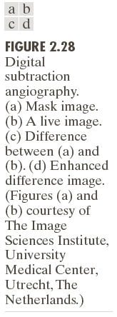
a is prior to the injection of the iodine medium to the patient’s blood stream
b is the sample of the live image after the medium was injected
c=a-b
d is after sharpening ad contrast enhancement

Slide 18
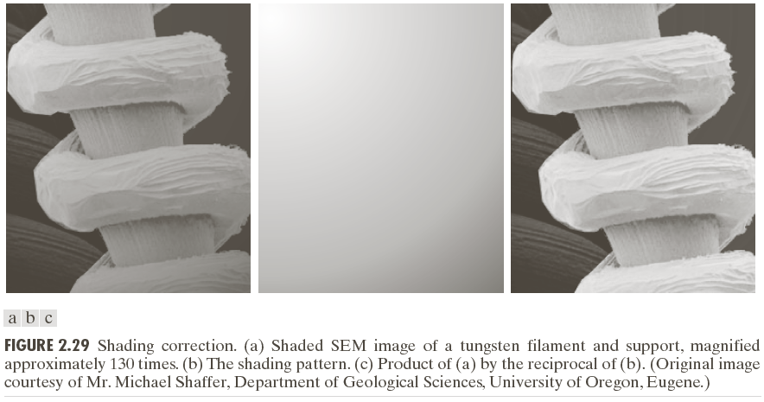

Slide 19
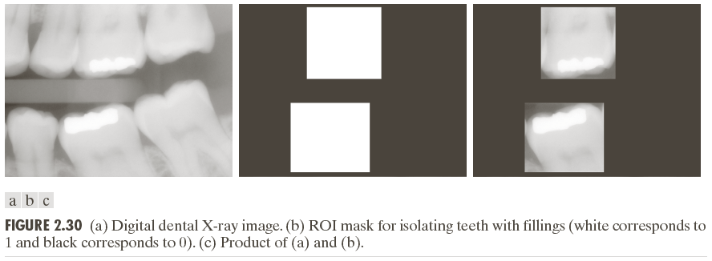

Slide 20
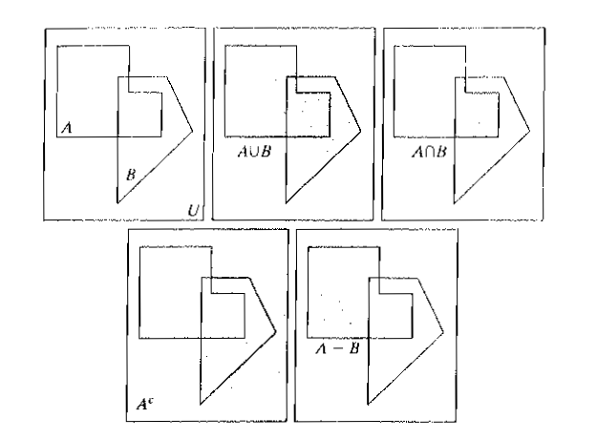

Set operations

Slide 21


Union: if A and B are two grayscale images their union will an array formed from the maximum intensity between the two corresponding pixel pairs
AUB= max(a,b)

Slide 22
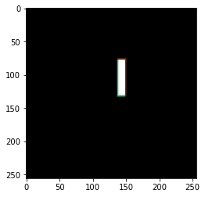
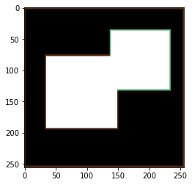
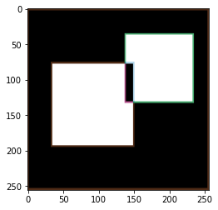
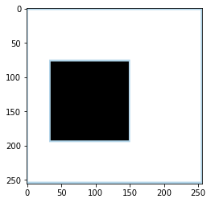

Slide 24
Logical operations
AND
Set of pixels belonging to both A and B
OR
Set of pixels belonging to either A or B
NOT
Not A: set of pixels not in A
A is the set of foreground pixels
NOT(A) becomes the background pixels

Slide 25
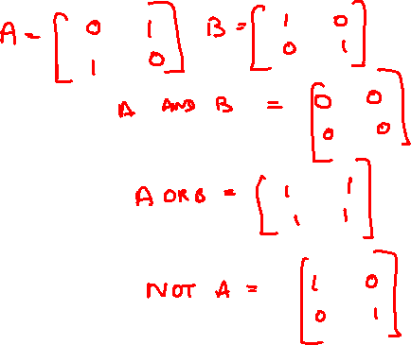
Logical operations
A_complement=not(B)
A union B = A OR B
A intersection B = A AND B

Slide 26

Spatial Operations
Single pixel operations
S=T(z)
Intensity transformation of a pixel
T is the transformation function
Neighborhood operations
Calculate the average values of the pixels in the neighborhood
$g\left(x,y\right)=\frac{1}{mn}\sum_{r,c∈S_{xy}}{f(r,c)}$
Performs local blurring of the image

Slide 27
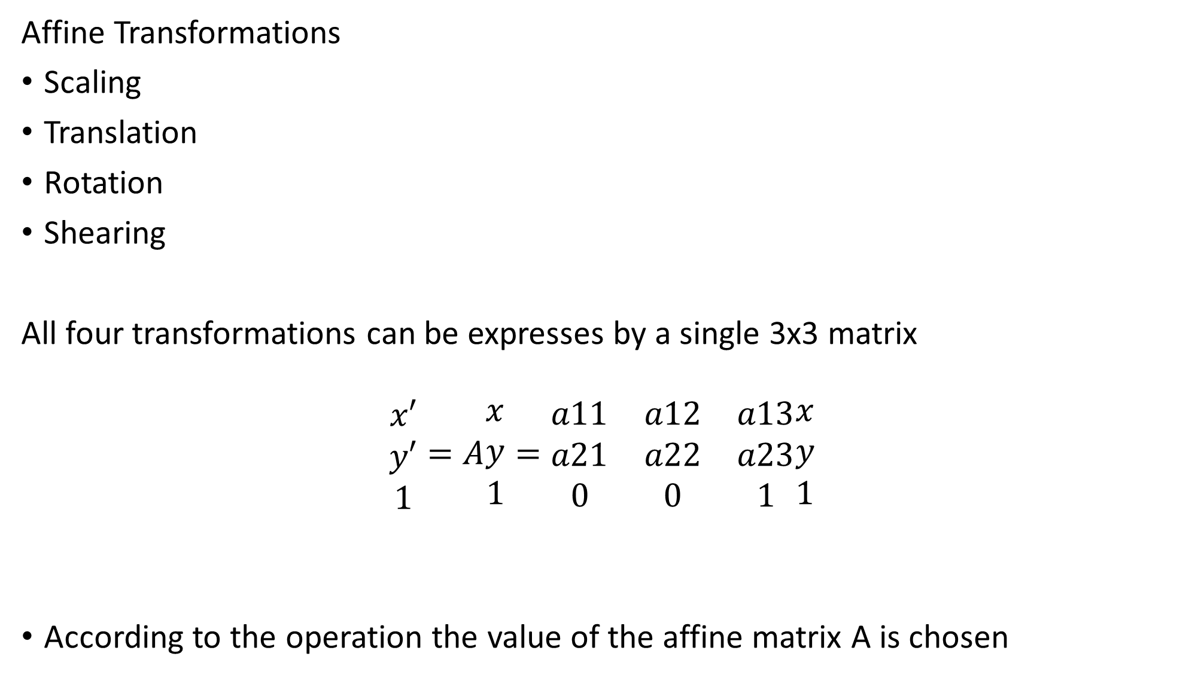
Affine Transformations
Scaling
Translation
Rotation
Shearing
All four transformations can be expresses by a single 3x3 matrix
$$\begin{matrix}x′ \\ y′ \\ 1\end{matrix}=A\begin{matrix}x \\ y \\ 1\end{matrix}=\begin{matrix}a11 & a12 & a13 \\ a21 & a22 & a23 \\ 0 & 0 & 1\end{matrix}\begin{matrix}x \\ y \\ 1\end{matrix}$$
According to the operation the value of the affine matrix A is chosen

Slide 28
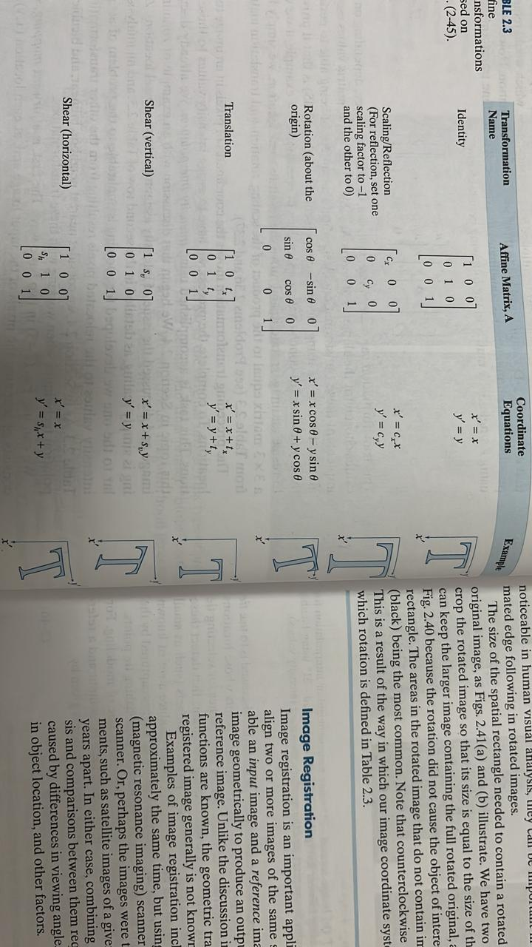

Slide 29

$\begin{matrix}1 & 2 \\ 3 & 4\end{matrix}$ $\begin{matrix}2 & 0 & 0 \\ 0 & 2 & 0 \\ 0 & 0 & 1\end{matrix}$
(1,1)---> (2,2)
(1,2)----> (2,4)
(2,1)---->(4,2)
(2,2)------>(4,4)
Scaling

Slide 30

$\begin{matrix}1 & 2 \\ 3 & 4\end{matrix}$ $\begin{matrix}cosθ & −sinθ & 0 \\ sinθ & cosθ & 0 \\ 0 & 0 & 1\end{matrix}$
(1,1)---> (0,2)
(1,2)----> ()
(2,1)---->()
(2,2)------>()
Rotation

Slide 31

$\begin{matrix}1 & 2 \\ 3 & 4\end{matrix}$ $\begin{matrix}1 & 0 & tx \\ 0 & 1 & ty \\ 0 & 0 & 1\end{matrix}$
(1,1)---> ()
(1,2)----> ()
(2,1)---->()
(2,2)------>()
Translation

Slide 32
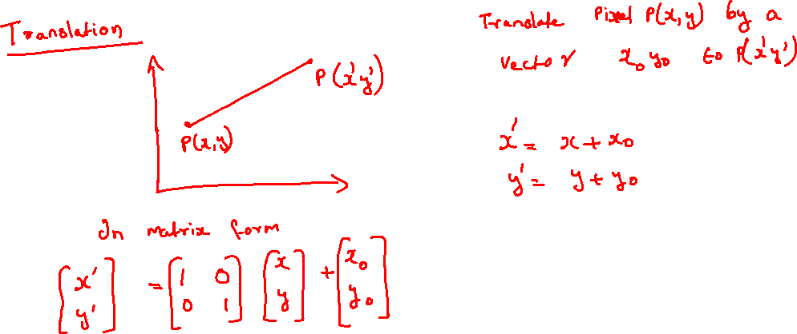
Geometric Transformations
Translation
Scaling
Rotation
Shearing
Translation

Slide 33
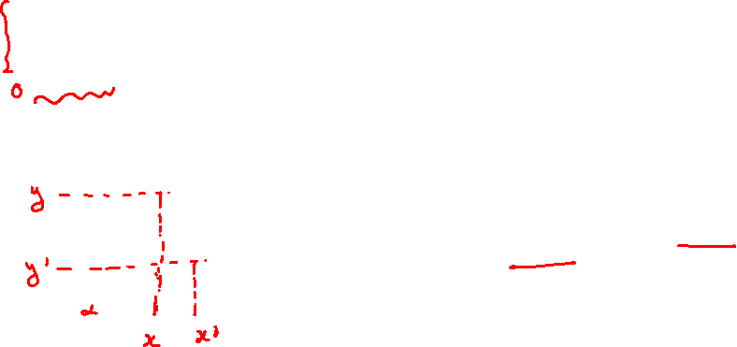
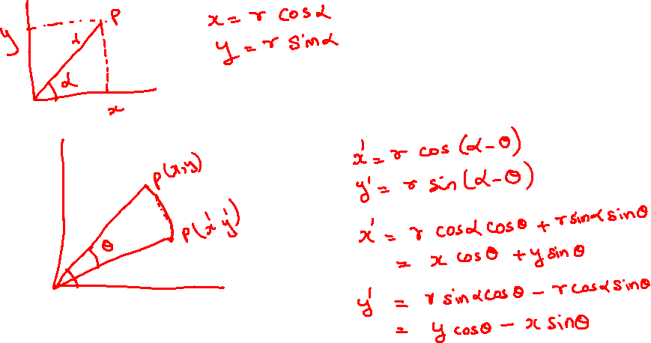
Rotation
You have a point p at a distance r from the origin
You want to rotate it in the clockwise direction by an angle alpha

Slide 34
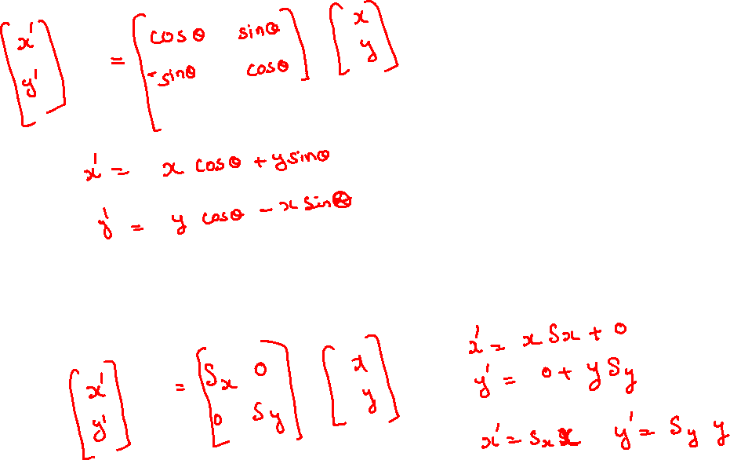
Scaling

Slide 35
Summary
Digital image fundamentals
Steps in digital image processing
Why do we want to digitize an image
Digitization process
Sampling quantization
Representation of digital image
Different types of images
Neighbors of a pixel
Connectivity
Adjacency
Path
Distance measures
Linear and nonlinear operations
Arithmetic operations
Logical operations
Set operations

Slide 36
Spatial operations
Geometric Transformations

